Slide 1

Chemistry Merit Badge
Troop 344/9344
Pemberville, OH

Slide 2
Requirements
Do EACH of the following activities:
  Describe three examples of safety equipment used in a chemistry laboratory and the reason each one is used.
  Describe what a safety data sheet (SDS) is and tell why it is used.
  Obtain an SDS for both a paint and an insecticide. Compare and discuss the toxicity, disposal, and safe-handling sections for these two common household products.
  Discuss the safe storage of chemicals. How does the safe storage of chemicals apply to your home, your school, your community, and the environment?

Slide 3
Requirements
Do EACH of the following activities:
  Predict what would happen if you placed an iron nail in a copper sulfate solution. Then, put an iron nail in a copper sulfate solution. Describe your. observations and make a conclusion based on your observations. Compare your prediction and original conclusion with what actually happened. Write the formula for the reaction that you described.
  Demonstrate how you would separate sand (or gravel) from water. Describe how you would separate table salt from water, oil from water, and gasoline from motor oil. Name the practical processes that require these kinds of separations and how the processes may differ.
  Describe the difference between a chemical reaction and a physical change. Observe one of each and share your observations with your counselor.
Construct a Cartesian diver. Describe its function in terms of how gases in general behave under different pressures and different temperatures. Describe how the behavior of gases affects a backpacker at high altitudes and a scuba diver underwater.

Slide 4
Requirements
Do EACH of the following activities:
  Cut a round onion into small chunks. Separate the onion chunks into three equal portions. Leave the first portion raw. Cook the second portion of onion chunks until the pieces are translucent. Cook the third portion until the onions are caramelized, or brown in color. Taste each type of onion. Describe the taste of raw onion versus partially cooked onion versus caramelized onion. Explain what happens to molecules in the onion during the cooking process.
  Describe the chemical similarities and differences between toothpaste and an abrasive household cleanser. Explain how the end use or purpose of a product affects its chemical formulation.
  In a clear container, mix a half-cup of water with a tablespoon of oil. Explain why the oil and water do not mix. Find a substance that will help the two combine, and add it to the mixture. Describe what happened, and explain how that substance worked to combine the oil and water.
List the five classical divisions of chemistry. Briefly describe each one, and tell how it applies to your everyday life.

Slide 5
Requirements
Discuss with your counselor the 5 classical areas of chemistry (organic, inorganic, physical, analytical and biological), and two others from the following list. Explain what they are, and how they impact your daily life.
  Agricultural chemistry
  Atmospheric chemistry
  Computational chemistry
  Electrochemistry
  Environmental chemistry and green chemistry
  Flavor chemistry, fragrance chemistry, and food chemistry
  Medicinal and natural products chemistry
  Photochemistry
  Polymer chemistry
  Or another area of chemistry of your choosing

Slide 6
Requirements
Do EACH of the following activities:
  Name two government agencies that are responsible for tracking the use of chemicals for commercial or industrial use. Pick one agency and briefly describe its responsibilities.
  Define pollution. Explain the chemical impacts on the ozone layer and global climate change
  Using reasons from chemistry, describe the effect on the environment of ONE of the following:
    The production of aluminum cans
    Burning fossil fuels
    Single-use items, such as water bottles, bags, straws, or paper
  Briefly describe the purpose of phosphates in fertilizer and in laundry detergent. Explain how the use of phosphates in fertilizers affects the environment. Explain why phosphates have been removed from laundry detergents.

Slide 7
Requirements
Do ONE of the following activities:
  Visit a laboratory and talk to a chemist. Ask what that chemist does, and what training and education are needed to work as a chemist.
  Using resources found at the library and in periodicals, books, and the Internet (with your parent's permission), learn about two different kinds of work done by chemists, chemical engineers, chemical technicians, or industrial chemists. For each of the four positions, find out the education and training requirements.
  Visit an industrial plant that makes chemical products or uses chemical processes and describe the processes used. What, if any, by-products are produced and how they are handled.
  Visit a county farm agency or similar governmental agency and learn how chemistry is used to meet the needs of agriculture ,in your county.

Slide 8
Requirement 1
Do EACH of the following activities:
  Describe three examples of safety equipment used in a chemistry laboratory and the reason each one is used.

Slide 9
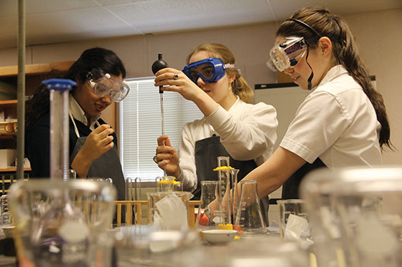
1a Lab Safety Equipment
Safety Goggles
  When working with chemicals, wear splashproof goggles to protect your eyes from spilled or splattered chemicals.
  Goggles worn around your neck or forehead do not protect your eyes.

Slide 10
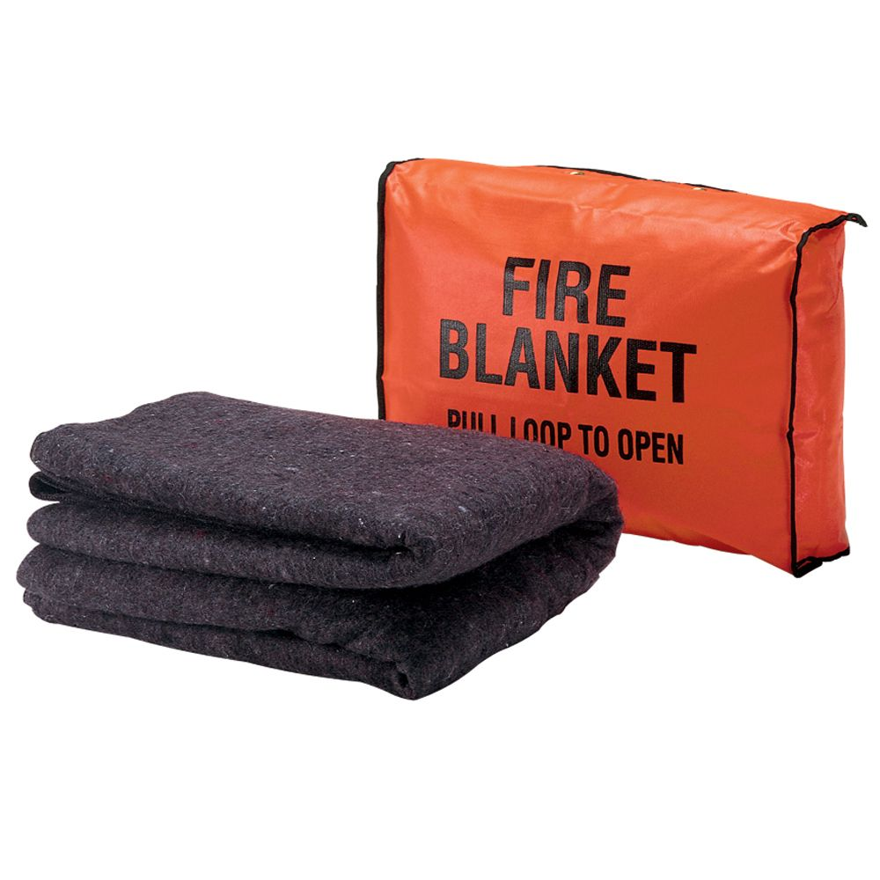
1a Lab Safety Equipment
Fire Blanket
  Most clothing is flammable.
  If someone’s clothing catches on fire, wrap the person in a fire blanket to cut off the supply of oxygen to the flames.

Slide 11
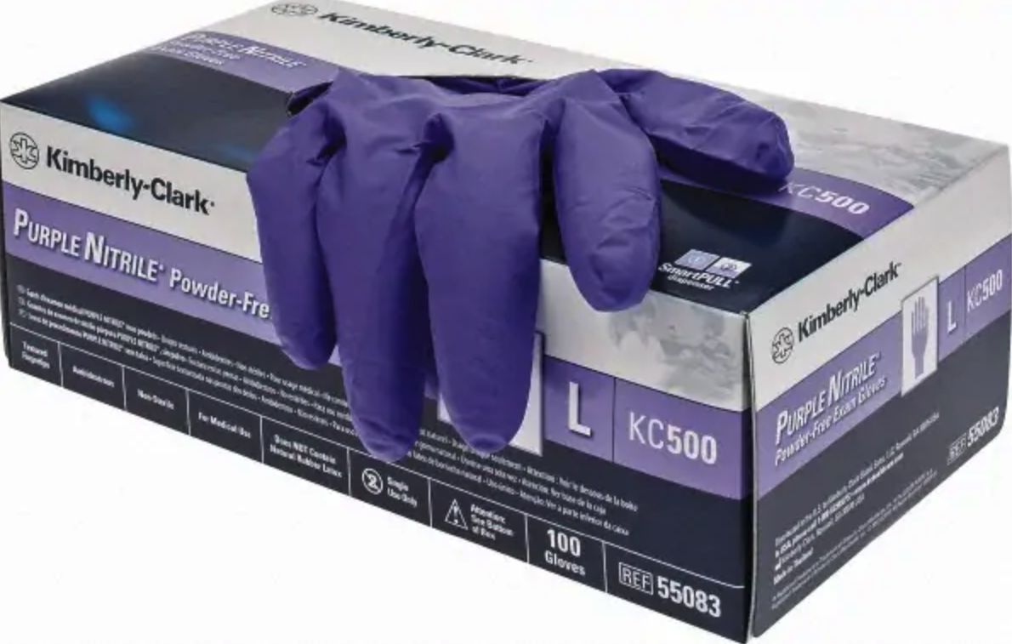
1a Lab Safety Equipment
Safety Gloves
  Disposable gloves like those used in the medical profession are safety gloves.
  Some chemicals, like acids, are unsafe for skin contact.
  Although some substances can soak through gloves, this extra layer of protection can save hands from a chemical burn.

Slide 12
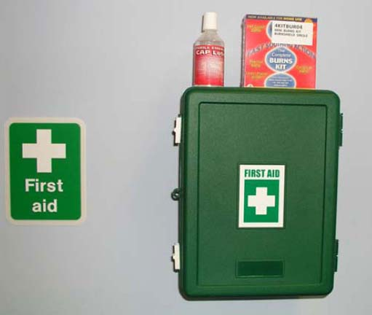
1a Lab Safety Equipment
First Aid Kit
  For minor cuts, burns, and abrasions, have a first aid kit handy.
  The supplies in a first aid kit also can work for temporary assistance until proper medical attention is available.

Slide 13
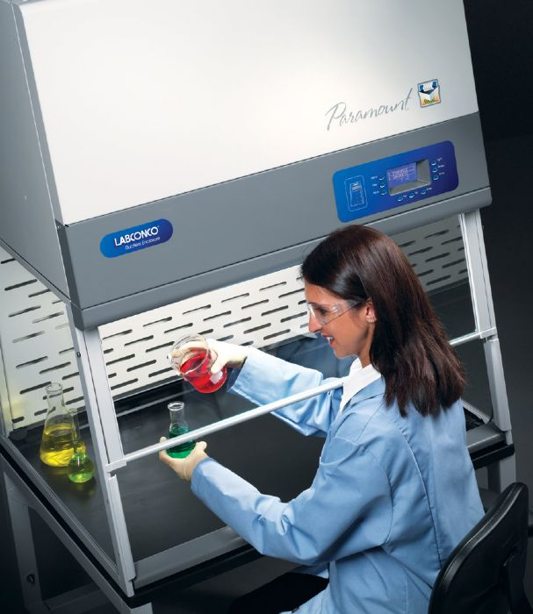
1a Lab Safety Equipment
Fume Hoods The fume hoods are large cabinets which have sliding glass doors in front. Fume hoods are used to protect you from harmful fumes, gases and odors.

Slide 14
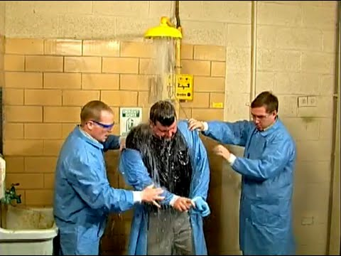
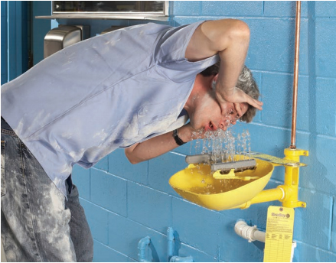
1a Lab Safety Equipment
Safety showers and eye wash stations The treatment for any chemicals which get on the body is to rinse the affected body area for 15 minutes under cold running water (or as long as you can stand it).

Slide 15
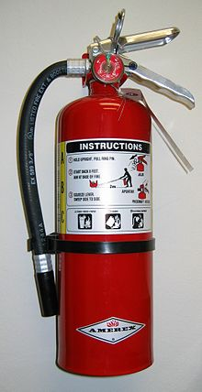
1a Lab Safety Equipment
Fire extinguishers There are fire extinguishers in each laboratory. While you are in the laboratory, please look carefully at the fire extinguishers. Notice how they are attached to the wall, and what you would have to do to get them off of the wall. Read the instructions on how to use.

Slide 16
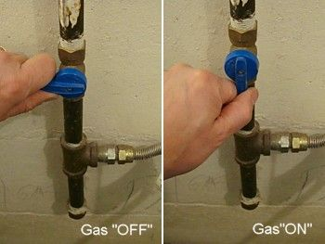
1a Lab Safety Equipment
Gas shutoff valve Each lab has a master valve which shuts off the gas supply to the entire lab.

Slide 17
Requirement 1
Do EACH of the following activities:
  Describe what a safety data sheet (SDS) is and tell why it is used.

Slide 18
1b What is a MSDS and its purpose?
The MSDS lists:
  the hazardous ingredients of a product,
  its physical and chemical characteristics (e.g. flammability, explosive properties),
  its effect on human health,
  the chemicals with which it can adversely react,
  handling precautions,
  the types of measures that can be used to control exposure,
  emergency and first aid procedures,
  and methods to contain a spill.

Slide 19
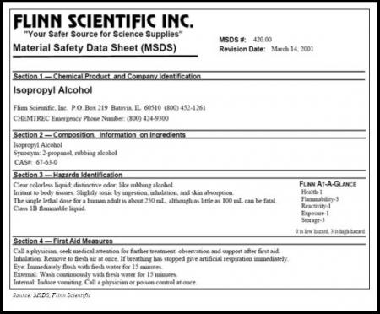

Slide 20
1b MSDS's Are Meant For
Employees who may be occupationally exposed to a hazard at work.
Employers who need to know the proper methods for storage etc.
Emergency responders such as fire fighters, hazardous material crews, emergency medical technicians, and emergency room personnel.

Slide 21
Requirement 1
Do EACH of the following activities:
  Obtain an SDS for both a paint and an insecticide. Compare and discuss the toxicity, disposal, and safe-handling sections for these two common household products.

Slide 22
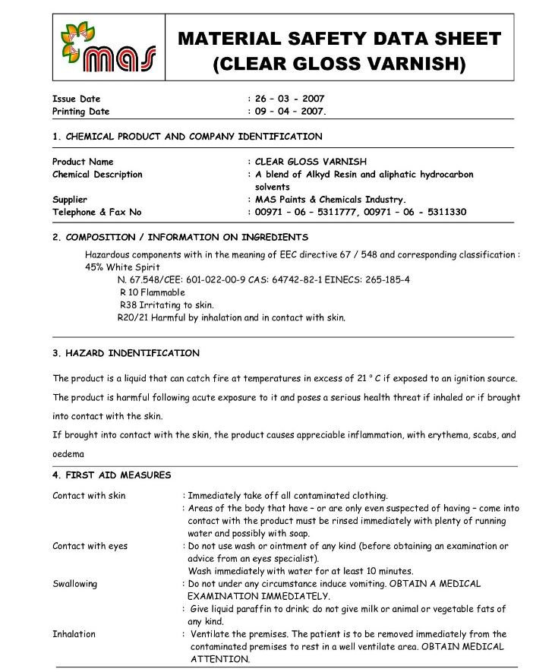

Slide 23
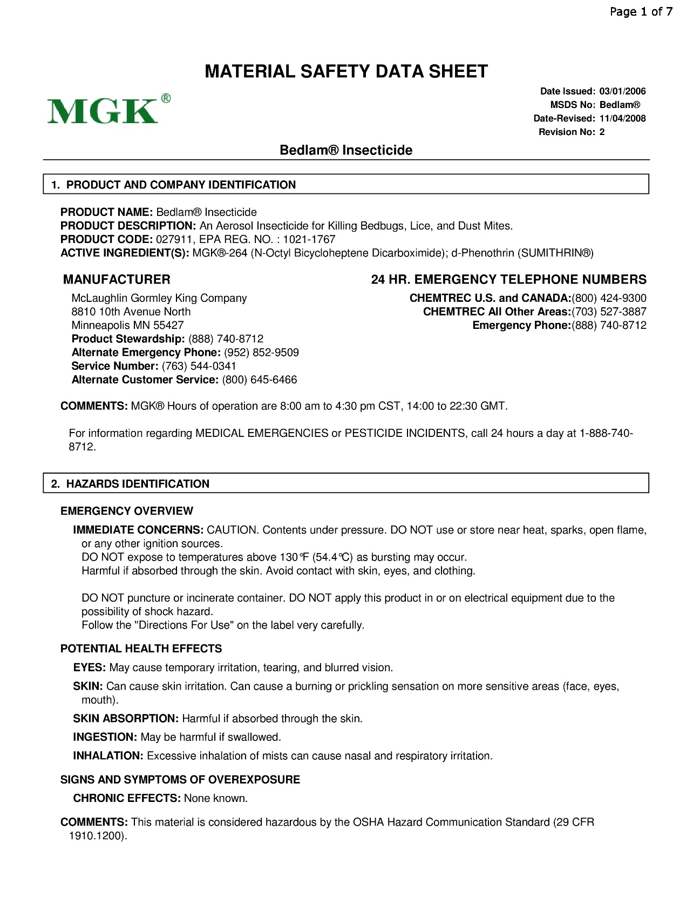

Slide 24
Requirement 1
Do EACH of the following activities:
  Discuss the safe storage of chemicals. How does the safe storage of chemicals apply to your home, your school, your community, and the environment?

Slide 25
1d Storage in Your Home
Home accidents can result from mixing one household chemical with another, not following directions for use of a product or by improper storage or disposal of a chemical.
  Some combinations of these products, such as ammonia and bleach, can create toxic gases.
  Some products should not be used in a small confined space to avoid inhaling dangerous vapors.
  Other products should not be used without gloves and eye protection to help prevent the chemical from touching your body.
Keep household chemicals out of sight and out of reach of children. If a child should eat or drink a chemical substance, find the containers immediately and call the Poison Control Center or 911.

Slide 26
1d Storage in Your School
At most schools, all chemicals are stored in a locked area, often organized by hazard classification.
Schools try to select less toxic chemicals and minimize chemical use to reduce waste and safety risk.
Teachers working with chemicals receive training in safe storage, proper use, potential hazards, and disposal.
Schools have a chemical spill plan in case of an accident.

Slide 27
1d Storage in Your Community and the Environment
Businesses in your community use chemicals that can be toxic if not stored or used correctly.
A spilled chemical on a business property could be washed by rain into a local stream, which could drain into a towns water supply.
Government regulates the proper use, storage, and disposal of chemicals.

Slide 28
Requirement 2
Do EACH of the following activities:
  Predict what would happen if you placed an iron nail in a copper sulfate solution. Then, put an iron nail in a copper sulfate solution. Describe your. observations and make a conclusion based on your observations. Compare your prediction and original conclusion with what actually happened. Write the formula for the reaction that you described.
  Demonstrate how you would separate sand (or gravel) from water. Describe how you would separate table salt from water, oil from water, and gasoline from motor oil. Name the practical processes that require these kinds of separations and how the processes may differ.
  Describe the difference between a chemical reaction and a physical change.

Slide 29
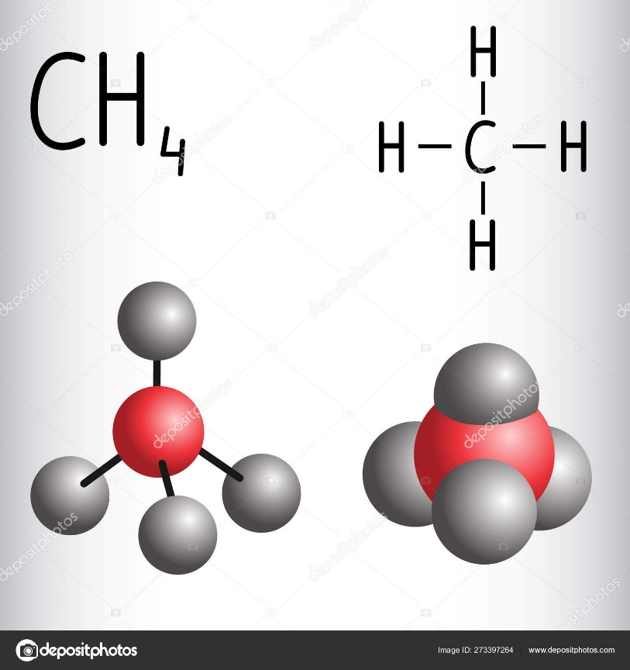
2a Chemical Formulas
When writing chemical formulas, chemists show the number of each type of atom in the compound.
The molecular formula of methane is CH₄ which means that there are four hydrogen (H) atoms and one carbon (C) atom in a molecule of methane

Slide 30
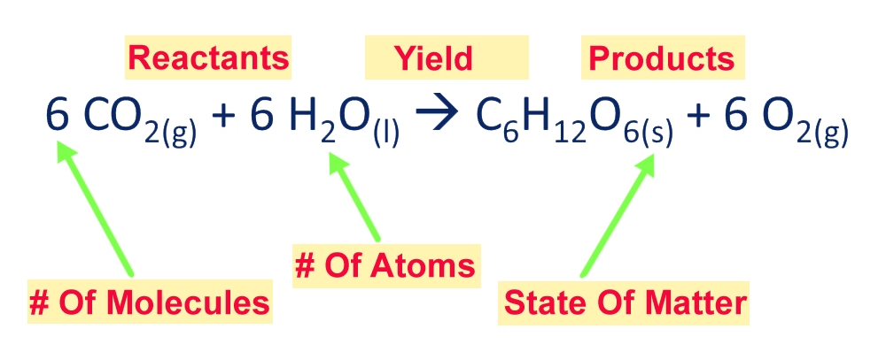
2a Chemical Equations
Chemists use equations to show the reactant and product molecules.
An equation for the photosynthesis is:

Slide 31
2a Iron in Copper Sulfate Experiment
When added together to a salt (i.e. copper sulfate) compound, any element on the metal activity series can displace any element listed below it.
Based on the activity series chart shown on the next slide, form a hypothesis of what would happen if an iron nail was submerged in a copper sulfate solution

Slide 32
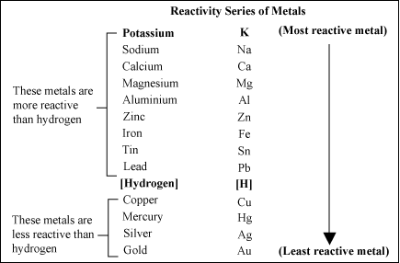

Slide 33
2a Iron in Copper Sulfate Experiment
Wearing safety goggles, place a clean iron nail in a clear plastic cup.
  A long nail works best.
Get some copper sulfate (CuSO₄), which is sold as root killer at hardware stores.
Dissolve some copper sulfate in another cup of water.
Transfer some blue copper sulfate solution to the cup with the nail, preferably leaving the top of the nail out of the solution for comparison.

Slide 34
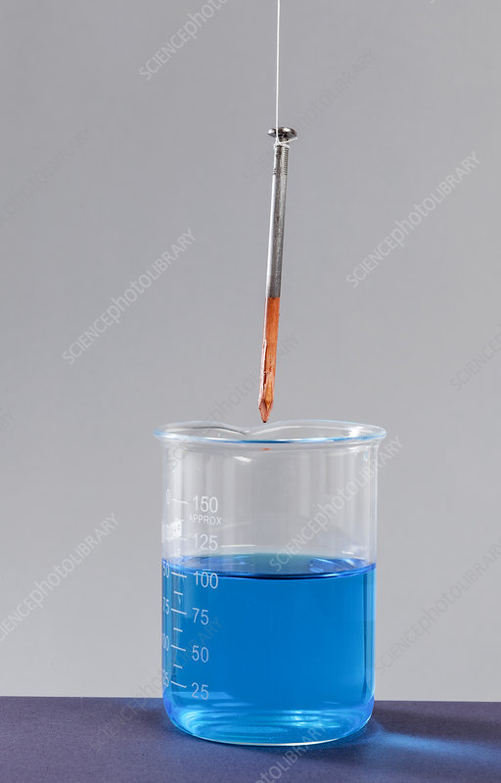
2a Iron in Copper Sulfate Experiment
What happened in 5, 10, and 20 minutes?
How do the results compare with your hypothesis?

Slide 35
2a Iron in Copper Sulfate Experiment
Fe (s) + CuSO₄ (aq) → Cu (s) + FeSO₄ (aq)
On the surface of the nail, iron (Fe) loses electrons to copper ions.
The iron ions combine with the sulfate to produce iron sulfate (FeSO₄), while the copper ions gain the electrons to become copper metal.
The surface of the nail should show a red-brown or copper color.
The blue copper sulfate solution will become a lighter blue.

Slide 36
2a Iron in Copper Sulfate Experiment
Each metal in the activity series is capable of displacing from solution the metal ions in any salt of any metal below it in the series.
In the experiment, since iron is above copper in the series, the iron displaced the copper ions in the copper sulfate solution.
The larger the interval between the elements, the more vigorous the reaction.

Slide 37
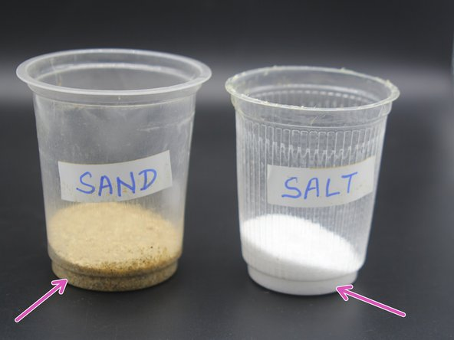
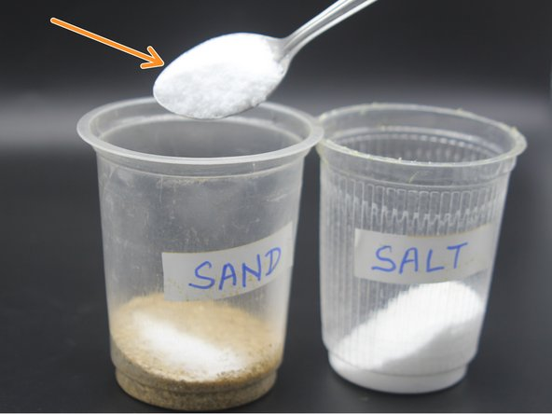
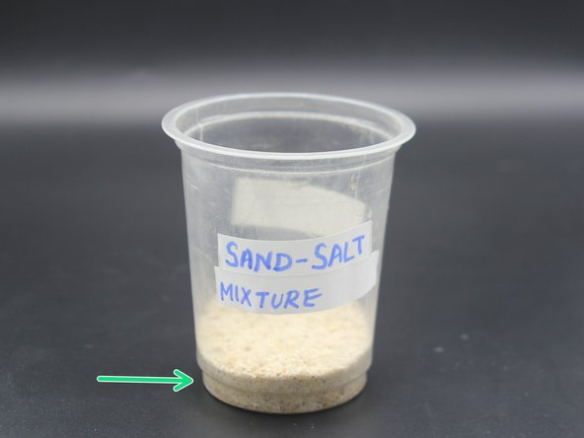
2b,c Separating Sand and Salt from Water Experiment
Step 1 - Mixing of Salt and Sand
  Collect sufficient amount of sand and salt in different glasses.
  Transfer two tablespoon of salt to the glass containing sand.
  Stir the Salt-Sand mixture well with a spoon .

Slide 38
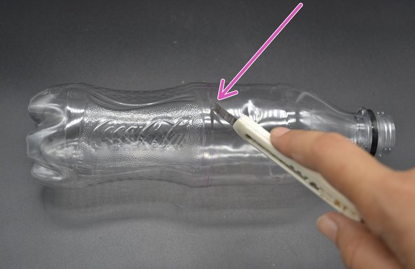
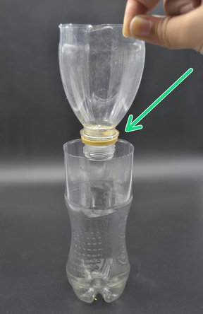
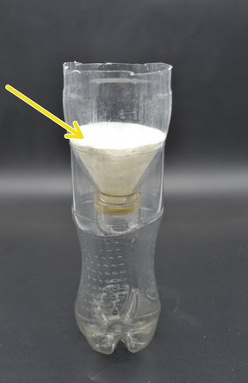
2b,c Separating Sand and Salt from Water Experiment
Step 2 - Cutting the Bottle
  Remove the bottle cap and cut the bottle in half using a cutter.
  Place the upper half of the bottle inverted on the lower half.
  Place a filter paper in the inverted part of the bottle. This acts like a funnel

Slide 39
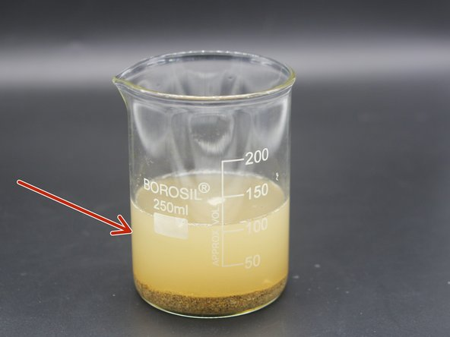
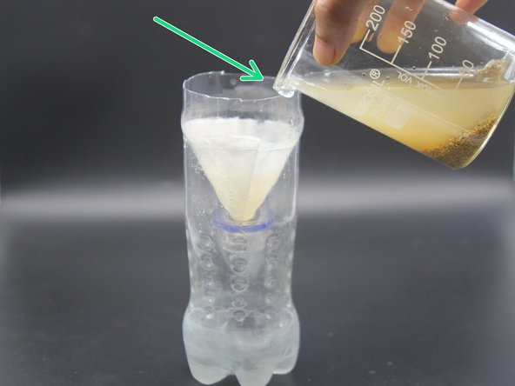
2b,c Separating Sand and Salt from Water Experiment
Step 3 - Sedimentation and Filtration
  Add water to the sand-salt mixture. Wait till the sand settles down (Sedimentation).
  Gently pour the mixture into the empty bottle through the funnel (Filtration).

Slide 40
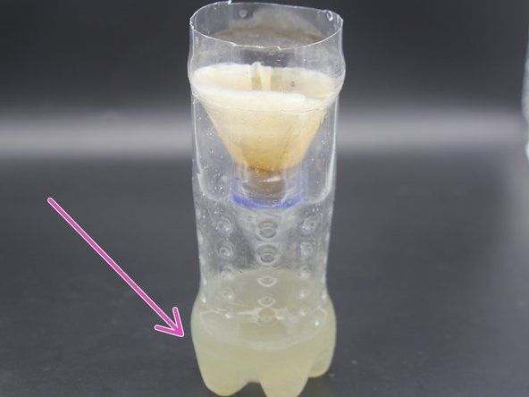
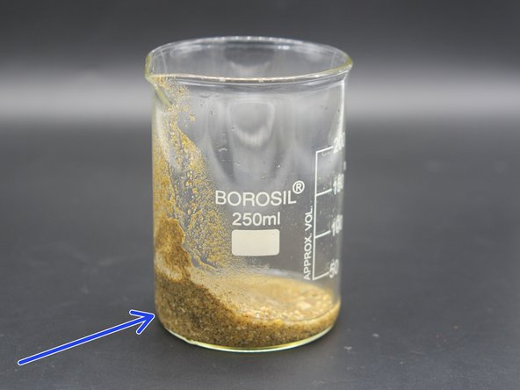
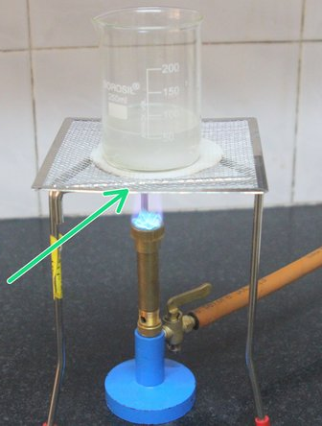
2b,c Separating Sand and Salt from Water Experiment
Step 4 - Evaporation
  Salt solution gets filtered down the funnel and is collected at the bottom of the bottle leaving the sand particles in the filter paper.
  Collect the sand in a beaker and keep it aside.
  Take the salt solution (filtrate) in a beaker and heat it.

Slide 41
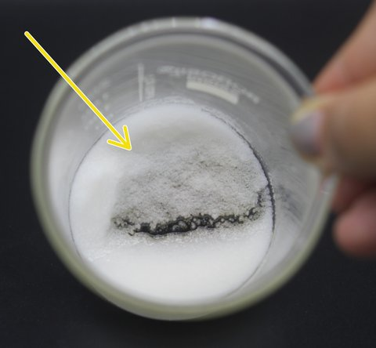
2b,c Separating Sand and Salt from Water Experiment
Step 5 - Salt Residue
  Heat until the water evaporates leaving the salt behind.

Slide 42
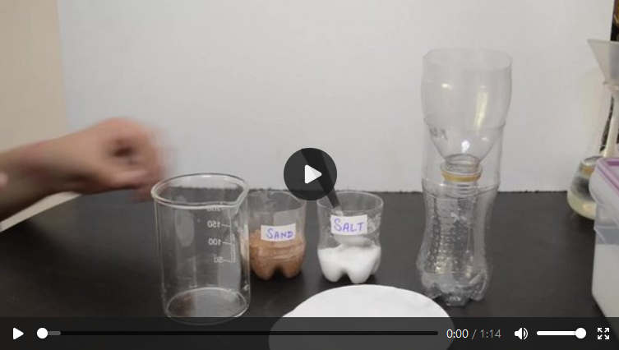
Mixture Separation Salt and Sand
Click on image for video of experiment.

Slide 43
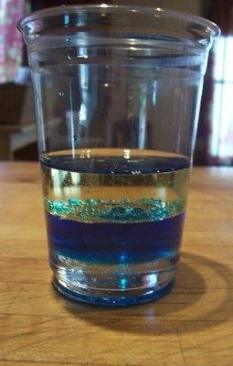
2b Separating Oil from Water
Fill a disposable plastic cup with half oil and half water.
Add few drops of food coloring and stir to mix.
Let the oil and water separate into two layers.
Poke a hole with a pencil near the bottom of the cup and watch the water flow out of the drain hole, as it would in an oil/water separator.

Slide 44
2b Separating Gasoline from Motor Oil
In your garage, you might find gas-powered equipment that operate on a mixture of gasoline and motor oil.
Because they have different boiling points, they can be separated by distillation.
Heat is added through distillation and the vapors are captured and condensed.
The product that boils at a lower temperature will be separated out first.

Slide 45
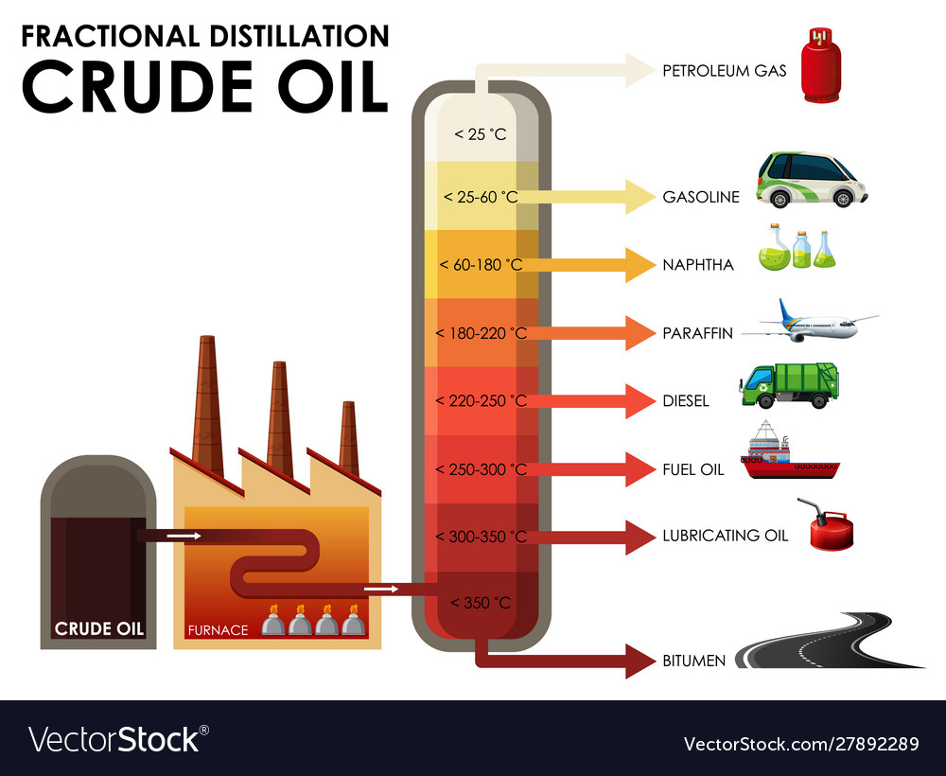

Slide 46
2c Chemical and Physical Changes
A chemical change results from a chemical reaction where the atoms in a molecule are combined or rearranged with atoms in another molecule to form a new compound that has different physical and chemical properties
A physical change is when matter changes forms but not chemical identity.
Examples of chemical changes are burning, cooking, rusting, and rotting.
Examples of physical changes are boiling, melting, freezing, and shredding

Slide 47
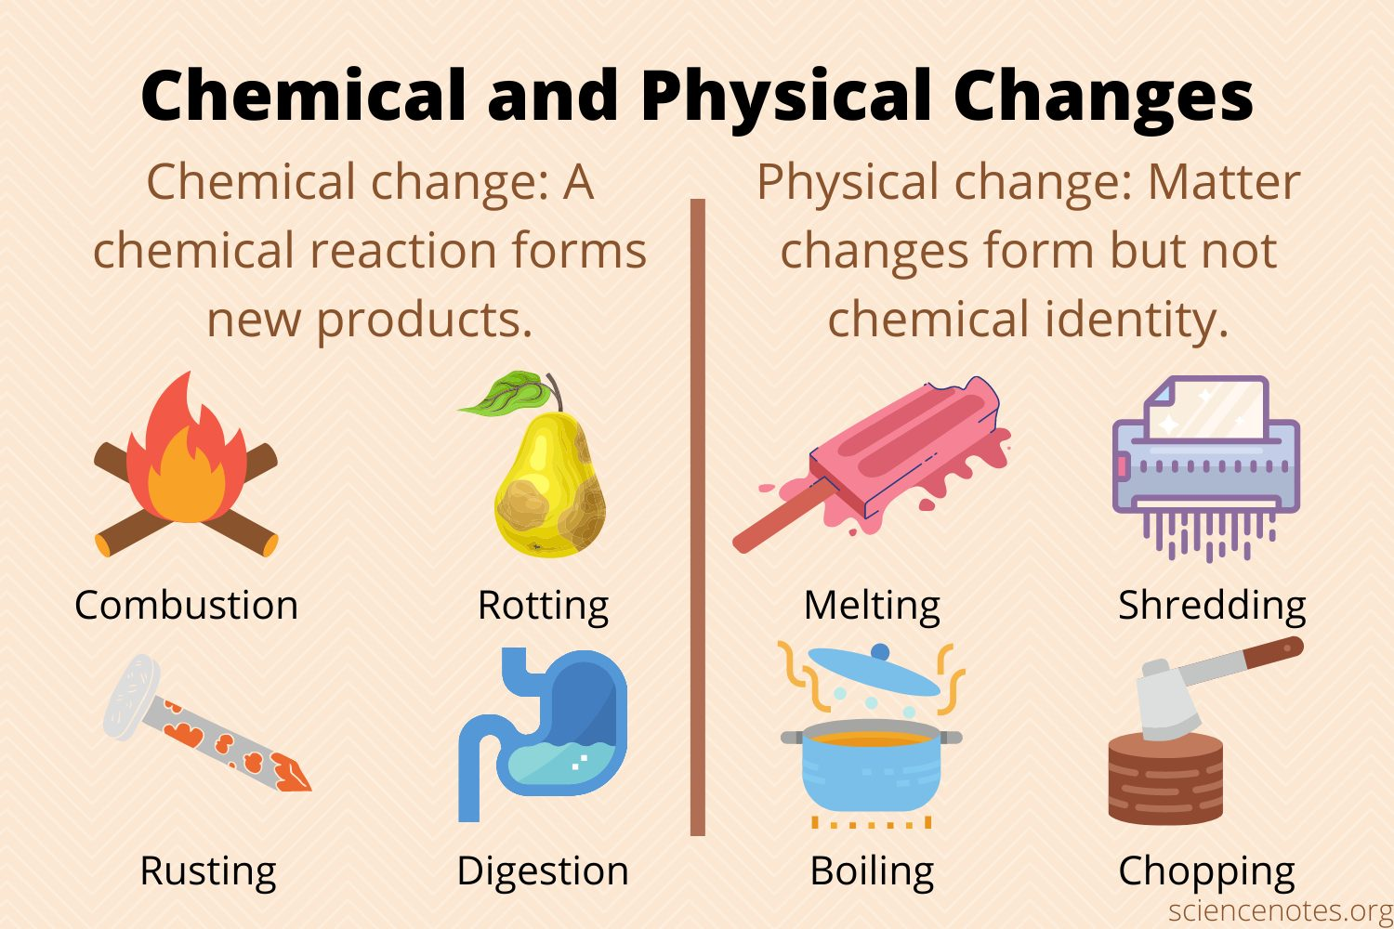

Slide 48
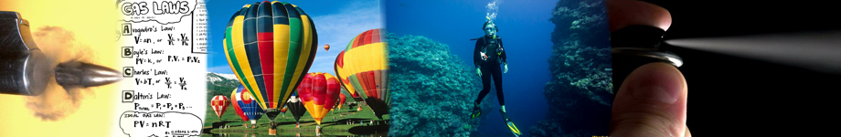
Requirement 3
Construct a Cartesian diver. Describe its function in terms of how gases in general behave under different pressures and different temperatures. Describe how the behavior of gases affects a backpacker at high altitudes and a scuba diver underwater.

Slide 49
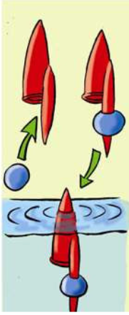
3 Cartesian Diver
Make a Cartesian diver that will float and dive over and over.
Step 1 – Using a writing pen cap, add some clay to the tip of the lid. Put the pen cap with the hole side down so that air is trapped inside, in a glass of water. If it floats with the tip of the cap just above the water, go to the next step. Otherwise, add or remove clay until it floats as needed.

Slide 50
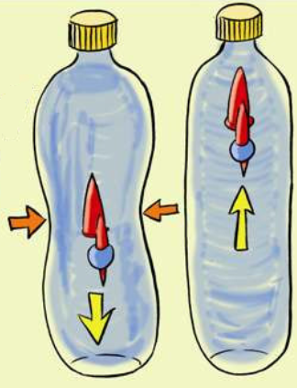
3 Cartesian Diver
Step 2 – Fill a clean clear plastic soft drink bottle to the very top with water. Float the pen cap in the bottle. Screw on the bottle cap tightly.
Step 3 – Squeeze the sides of the bottle. The diver should sink to the bottom.
Step 4 – Relax your grip on the bottle. What did the diver do?

Slide 51
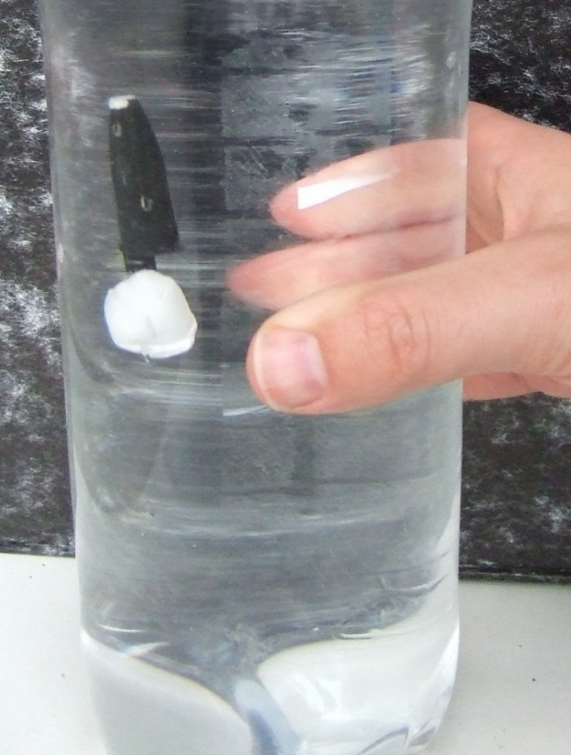
3 Effects of Pressure on a Gas
How does it work?
  The “diver” is an open-ended object, which contains a small amount of air placed in an airtight container of water.
  The bubble of air in the diver makes it buoyant.
  When the container is squeezed, the water pressure squeezes the bubble of air inside the “diver”.
  As the bubble gets smaller its buoyancy is reduced until the “diver” becomes negatively buoyant and sinks.
  When the pressure on the container is released, the bubble expands, increases in buoyancy, the “diver” becomes positively buoyant and floats.

Slide 52
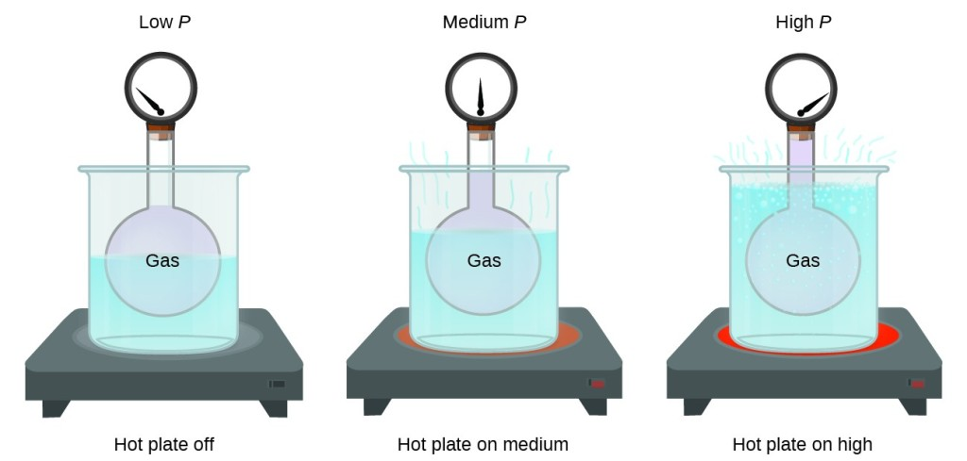
3 Effects of Temperature on Gases
If the temperature of a gas is increased, the volume of the gas increases.
If the temperature of a gas is decreased, the volume of the gas decreases.
This means that the volume of a gas is directly proportional to its temperature.

Slide 53
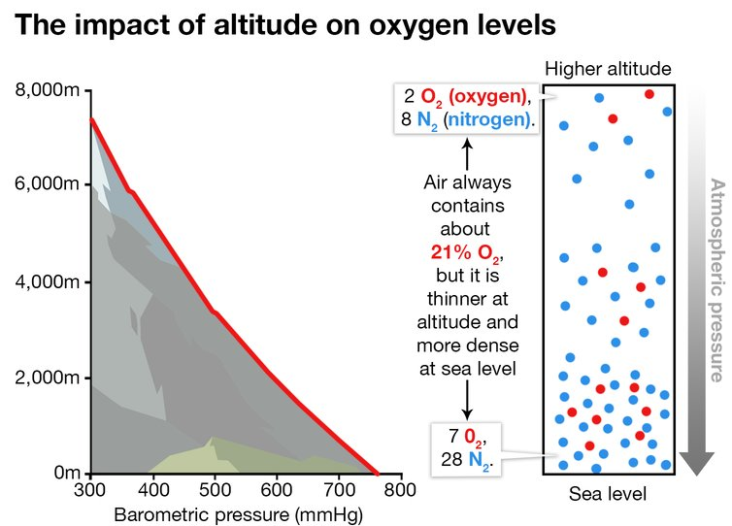
3 Backpacking at Altitude
The earth’s atmosphere has about 21% oxygen.
As your altitude increases, air pressure decreases and air molecules float farther apart.
When you inhale air at high altitudes, a smaller number of oxygen molecules fill your lungs.
At high altitudes, you must breathe faster to supply the same amount of oxygen to your blood as you would at a lower altitude.

Slide 54
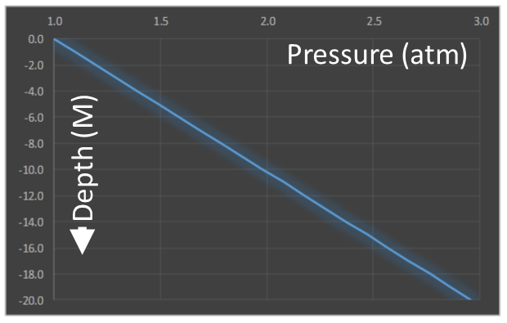

3 Scuba Diving
As a scuba diver descends to the ocean floor, the water pressure increases.
The weight of water above the diver pushes down on the lower water, increasing the pressure.
The high-pressure water squeezes the diver’s chest.
Divers need to breathe high-pressure air to fill their lungs.

Slide 55
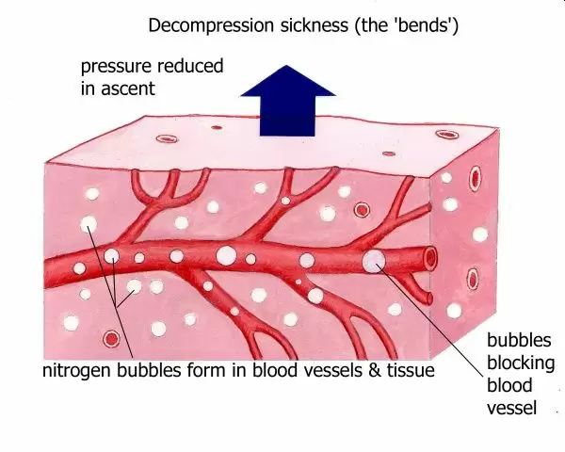
3 Scuba Diving
At a higher pressure, the body accumulates nitrogen in the blood and tissues.
When the diver returns to the surface and the air pressure decreases, the body releases the excess nitrogen when exhaling, if the diver ascends slowly enough.
If the diver comes to the surface too quickly, nitrogen bubbles form in the tissues resulting in decompression sickness.
Decompression sickness can cause the diver to bend over in pain and is why the condition is also called the bends.

Slide 56
Requirement 4
Do EACH of the following activities:
  Cut a round onion into small chunks. Separate the onion chunks into three equal portions. Leave the first portion raw. Cook the second portion of onion chunks until the pieces are translucent. Cook the third portion until the onions are caramelized, or brown in color. Taste each type of onion. Describe the taste of raw onion versus partially cooked onion versus caramelized onion. Explain what happens to molecules in the onion during the cooking process.
  Describe the chemical similarities and differences between toothpaste and an abrasive household cleanser. Explain how the end use or purpose of a product affects its chemical formulation.
  In a clear container, mix a half-cup of water with a tablespoon of oil. Explain why the oil and water do not mix. Find a substance that will help the two combine, and add it to the mixture. Describe what happened, and explain how that substance worked to combine the oil and water.

Slide 57
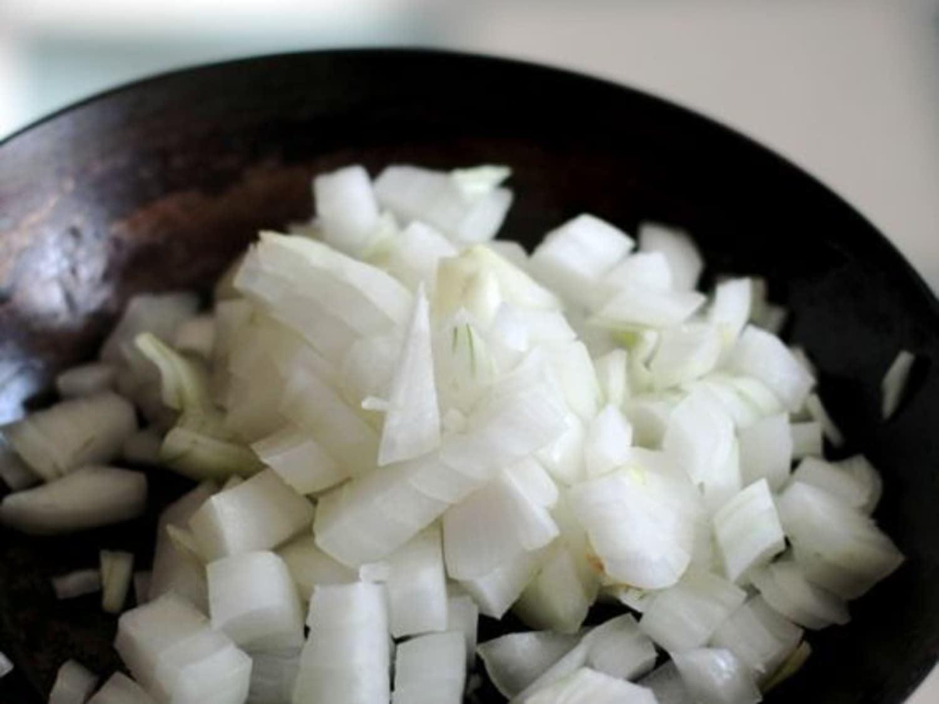
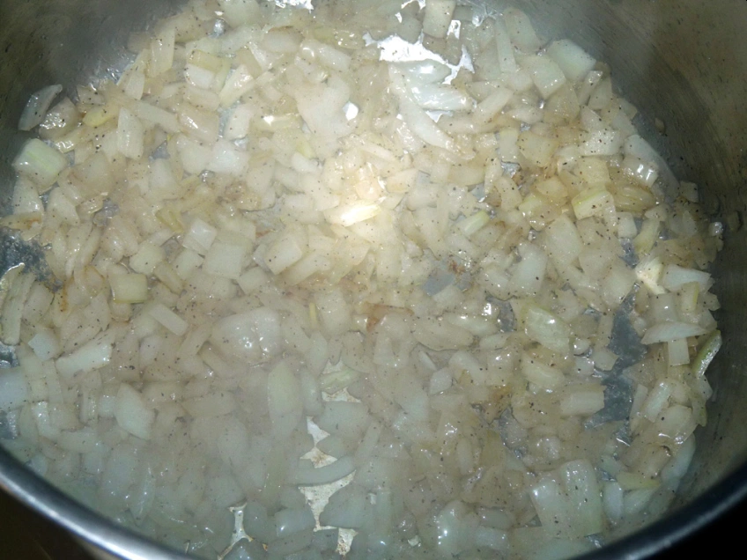
4a Onion Experiment
Use a knife to cut an onion into chunks.
Taste a piece of the raw onion.
Place a few tablespoons of cooking oil in a skillet and warm the oil over medium heat on a stove.
Add the onion chunks and cook for about three minutes while stirring, until the onion becomes translucent.
Remove half the onions and cool.
Taste a translucent onion.
How does it taste different from the raw onion?

Slide 58
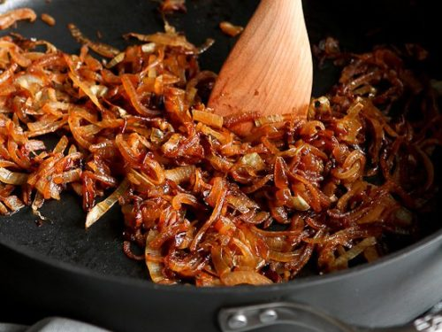
4a Onion Experiment
Continue cooking and stirring the remaining onions in the pan for another 10 minutes over medium heat.
The onion will become brown, or caramelized.
Remove the onion from the heat and allow it to cool.
Taste the caramelized onion.
How does it taste compared with the raw and translucent onion?

Slide 59
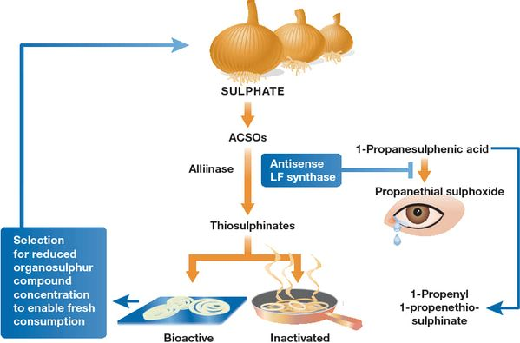
4a Onion Experiment
How It Works
In the raw onion, you taste the bitter thiosulfates.
Thiosulfates are volatile, which means they evaporate easily.
When the onion is heated in cooking, most of the thiosulfates evaporate and the enzyme that produces them is destroyed, so the translucent onion does not taste as bitter.
When the onion is further cooked to caramelization, it turns brown and the onion’s carbohydrates are converted into simple sugars like fructose and glucose, making the onion taste sweet.

Slide 60
4b Toothpaste vs. Abrasive Cleanser
Rub some toothpaste between two fingers. Now do the same with an abrasive household cleaner and a drop of water. How are they the same?
Copy the table below and fill in the blanks.
Type of Ingredient | Toothpaste | Household Cleaner
Abrasive (often carbonate or phosphate)
Surfactant (detergent like sarcosinate)
Solvent (water)
Fluoride (enamel hardener)
Additives (perfume, color, flavor)

Slide 61
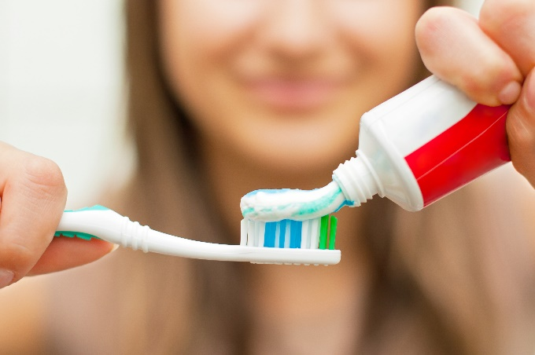
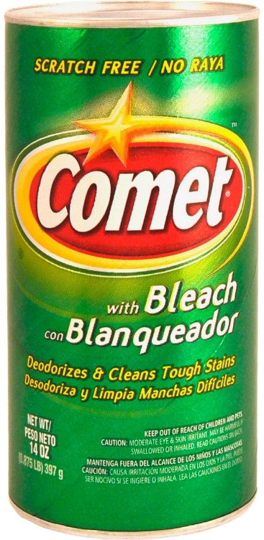
4b Toothpaste vs. Abrasive Cleanser
Both items clean by using abrasive action and a detergent.
Two important differences are the fluoride in the toothpaste and the type of detergent.
Fluoride reacts with tooth enamel to make it a harder surface, which is therefore less prone to tooth decay. Fluoride also fights cavity-causing bacteria
The type of detergent is called a carbonate. Calcium carbonate is typically present in both products, but sodium carbonate is in only the abrasive household cleaner. Sodium carbonate is a harsher abrasive. If sodium carbonate were used on your teeth, it would scratch the enamel.

Slide 62
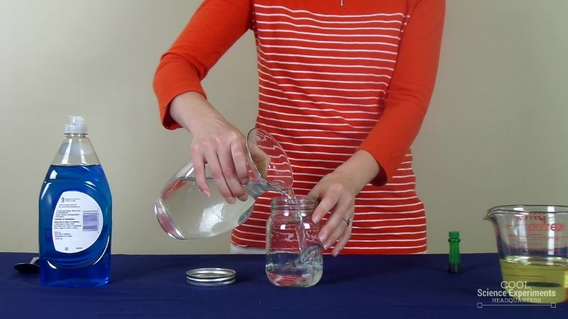
4c Oil and Water Experiment
Step 1 – Start by filling the jar with 1 cup of water.
Step 2 – Add a few drops of food coloring to the water and stir until combined. Make some observations about the water. What happened when the food coloring was added? Was it easy to mix the food coloring into the water? Does the food coloring stay mixed with the water? What do you think will happen when we pour the oil into the jar? Write down your hypothesis (prediction) and then follow the steps below.

Slide 63
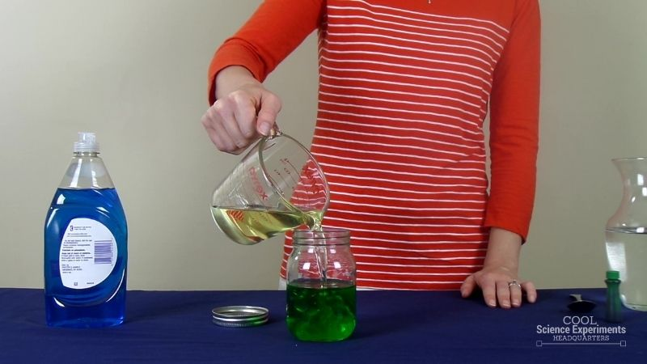
4c Oil and Water Experiment
Step 3 – Next pour 1 cup of oil into the jar. Make a few observations. Does the oil behave the same was as the food coloring did when you added it to the water?

Slide 64
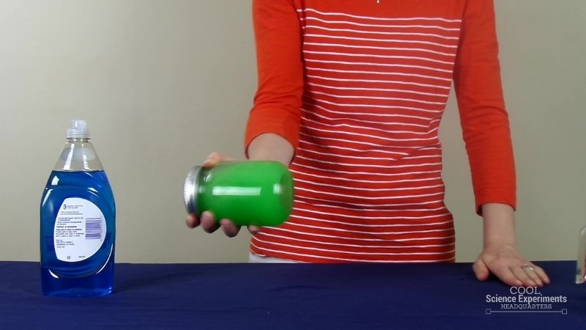
4c Oil and Water Experiment
Step 4 – Securely tighten the lid on the jar and shake it for 15-20 seconds.

Slide 65
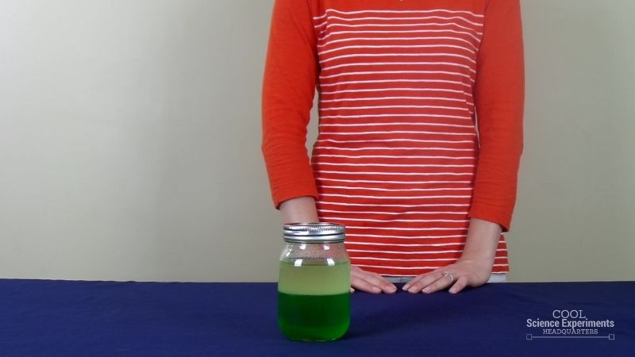
4c Oil and Water Experiment
Step 5 – Set the jar down and watch the jar for a couple of minutes. Observe what happens to the oil and the water and write down your findings. Did the oil and water stay mixed together? Was your hypothesis correct? Do you think there is anything else that can be added to the jar to prevent the oil and water from separating?

Slide 66

4c Oil and Water Experiment
Step 6 – Next, take the lid off the jar and squirt in 1-2 teaspoons of dish soap.

Slide 67

4c Oil and Water Experiment
Step 7 – Tighten the lid back on the jar and shake again for another 15-20 seconds.

Slide 68

4c Oil and Water Experiment
Step 8 – Set the jar down and watch the liquid for a minute or two. Observe what happens to the oil and the water now that the dish soap has been added to the mix. Write down your findings. Did the oil and water stay mixed together this time? Do you know why adding the dish soap preventing the oil and water from separating?

Slide 69
4c Oil and Water Experiment
Oil and water will not stay mixed together, no matter how hard you shake the jar.
Instead, the oil slowly rises to the top of the water.
This is because of the density of the two liquids.
  Density is a measure of the mass per unit volume of a substance.
  Water has a density of 1 g/mL (g/cm3). Objects will float in water if their density is less than 1 g/mL.
  Objects will sink in water if their density is greater than 1 g/mL.
  The oil is LESS dense than the water.
  This is because the molecules of oil are larger than the molecules of water, so oil particles take up more space per unit area.
  As a result, the oil will rise to the top of the water.

Slide 70
4c Oil and Water Experiment
Adding dish soap to the mixture changed the results of the experiment.
When oil, water and dish soap are mixed together, the oil and water don’t separate like they did when they were the only two items in the jar.
This is because of the chemistry of the oil, water and soap molecules.

Slide 71
4c Oil and Water Experiment
Oil (and other fats) are made of nonpolar molecules, meaning they cannot dissolve in water.
Water is made of polar molecules that can dissolve other polar molecules.
Soap is made of molecules that have a hydrophilic (“water-loving”) end and a hydrophobic (“water-fearing”) end.
Without soap, water and oil cannot interact because they are unlike molecules.
When you add soap to the mixture, the hydrophobic end of the soap molecule breaks up the nonpolar oil molecules, and the hydrophilic end of the soap molecule links up with the polar water molecules.
Now that the soap is connecting the fat and water, the non-polar fat molecules can be carried by the polar water molecules.
Now the oil and water can be mixed together and stay mixed together!

Slide 72
4c Oil and Water Experiment
Soap Cleans Greasy Dishes
  Trying to clean greasy and oily dishes with water alone is bound to fail, because the oil won't mix and will stay on the dishes, no matter how much water you use.
  Hot water helps, but only a little.
  You need soap to do the job correctly, because soap breaks the oil molecules apart and allows the water molecules to surround them, so they will wash away.

Slide 73
Requirement 5
Discuss with your counselor the 5 classical areas of chemistry (organic, inorganic, physical, analytical and biological), and two others from the following list. Explain what they are, and how they impact your daily life.
  Agricultural chemistry
  Atmospheric chemistry
  Computational chemistry
  Electrochemistry
  Environmental chemistry and green chemistry
  Flavor chemistry, fragrance chemistry, and food chemistry
  Medicinal and natural products chemistry
  Photochemistry
  Polymer chemistry
  Or another area of chemistry of your choosing

Slide 74

5 Analytical Chemistry
A branch of chemistry that deals with the identification of compounds and mixtures (qualitative analysis) and/or the determination of how much there is of each one of the constituents (quantitative analysis)
The principles of analytical chemistry are used to check the quality of foods, drugs, and other chemicals used in daily life.

Slide 75

5 Biochemistry
Biochemistry is the study of the chemical substances and processes that occur in plants, animals, and microorganisms and of the changes they undergo during development and life.
Biochemistry has applications in:
  Food Science - Biochemists determine the chemical composition of foods, research ways to develop abundant and inexpensive sources of nutritious foods, develop methods to extract nutrients from waste products, and/or invent ways to prolong the shelf life of food products.
  Agriculture - Biochemists study the interaction of herbicides/insecticides with plants and pests. They examine the structure–activity relationships of compounds, determine their ability to inhibit growth, and evaluate the toxicological effects on surrounding life.
  Pharmacology, Physiology, Microbiology, Toxicology, and Clinical Chemistry - Biochemists investigate the mechanisms of drug actions; engage in viral research; conduct research pertaining to organ function; or use chemical concepts, procedures, and techniques to study the diagnosis and therapy of disease and the assessment of health.

Slide 76

5 Inorganic Chemistry
Inorganic chemistry is the study of all elements and their compounds except carbon compounds.
Inorganic chemistry is fundamental to many practical technologies including catalysts, coatings, pigments and dyes, fuels, drugs, superconductors, energy conversion and storage, and electronics.
Inorganic compounds are also found in biological systems where they are essential to life processes.

Slide 77

5 Organic Chemistry
Organic chemistry is the study of the structure, properties, composition, reactions, and preparation of carbon-containing compounds.
Organic chemistry is often called the chemistry of life.
Everyday uses of organic chemistry include gasoline, plastics, detergents, dyes, food additives, natural gas, and medicines.

Slide 78

5 Physical Chemistry
Physical chemistry deals with the principles of physics involved in chemical interactions and examines:
  How matter behaves on a molecular and atomic level
  How chemical reactions occur
Physical chemistry has played a key role in the development of the liquid crystals and picture tubes used for the display of information in watches and televisions.
The application of physical chemistry principles has led to faster and more efficient computers.
In an age of worldwide energy shortages, physical chemists are developing electrolysis cells that use sunlight rather than electricity to generate hydrogen fuel.

Slide 79
5h. Photochemistry
Photochemistry is the branch of chemistry concerned with the chemical effects of light.
•Example: Photosynthesis
–the process by which green plants and some other organisms use sunlight to synthesize foods (which we eat) from carbon dioxide and water.
–Photosynthesis generates oxygen as a byproduct (which we breathe).

Slide 80
5i. Polymer Chemistry
Polymer chemistry is a branch of chemistry that focuses on any of a class of natural or synthetic substances composed of very large molecules that are multiples of simpler chemical units.
•Vulcanized rubber is a synthetic (man-made) polymer found in automobile and bike tires.

Slide 81
Requirement 6
Do EACH of the following activities:
  Name two government agencies that are responsible for tracking the use of chemicals for commercial or industrial use. Pick one agency and briefly describe its responsibilities.
  Define pollution. Explain the chemical impacts on the ozone layer and global climate change
  Using reasons from chemistry, describe the effect on the environment of ONE of the following:
    The production of aluminum cans
    Burning fossil fuels
    Single-use items, such as water bottles, bags, straws, or paper
  Briefly describe the purpose of phosphates in fertilizer and in laundry detergent. Explain how the use of phosphates in fertilizers affects the environment. Explain why phosphates have been removed from laundry detergents.

Slide 82


6a Government Agencies
Occupational Safety and Health Administration (OSHA) monitors exposure to chemicals in the workplace and MSDS reporting.
The Food and Drug Administration (FDA) protects the public health by monitoring dietary supplements, drugs, vaccines, animal feed, and even radiation emitting products like microwaves.

Slide 83

6a Government Agencies
The Environmental Protection Agency (EPA) protects human health and the air, water, and land upon which our health depends. The EPA conducts research before setting national standards and delegating them to states to implement.

Slide 84



6b Pollution
Pollution is the introduction of harmful materials into the environment. These harmful materials are called pollutants. Pollutants can be natural, such as volcanic ash. They can also be created by human activity, such as trash or runoff produced by factories. Pollutants damage the quality of air, water, and land.

Slide 85
6b Pollution and the Ozone Layer
The hole in the ozone layer is caused by air pollutants.
Chemicals used as refrigerants, such as chlorofluorocarbons (CFCs), contain chlorine atoms.
Releasing chlorine atoms into the atmosphere destroys ozone.
A single chlorine atom can destroy thousands of ozone molecules.
The ozone layer blocks harmful UVB radiation from the Sun- it protects us in a way that is similar to putting sunscreen on your skin to prevent sunburn.
The ozone hole puts all living things at risk by increasing the amount of UVB that reaches the surface.
Exposure to UVB increases the risk of skin cancer in humans, restricts growth and development in plants, slows the development of fish and amphibians, and reduces the number of phytoplankton in marine ecosystems.
UVB also causes natural and synthetic materials to breakdown at an accelerated rate.

Slide 86

6b Pollution and the Ozone Layer
In 2019 the ozone hole over Antarctica (shown in blue) was the smallest it has been since the hole was discovered. Since the banning of CFCs, the ozone hole continues to shrink, but scientists warn that complete recovery is still uncertain.

Slide 87

6b Pollution and Ozone
Although ozone in the stratosphere protects us, breathing ozone is harmful for plants and animals, especially people who have breathing problems like asthma.
In cities, ozone is produced the interaction of hydrocarbons and nitrogen oxides from auto exhausts under the influence of sunlight and is a major and dangerous component of smog.
According to the World Health Organization, an estimated seven million people die each year from air pollution.
Ground-level ozone causes muscles in the lungs to contract, making it difficult to breathe and exposure to high ozone levels can cause sore throat, coughing, lung inflammation, and permanent lung damage.
Ozone pollution harms plants by damaging structures called stomata, which are tiny pores on the underside of leaves that allow the plant to "breathe."

Slide 88

6b Pollution and Global Warming
Global warming is the unusually rapid increase in Earth’s average surface temperature over the past century primarily due to the greenhouse gases released by people burning fossil fuels.
How Does Today’s Warming Compare to Past Climate Change?
Earth has experienced climate change in the past without help from humanity. But the current climatic warming is occurring much more rapidly than past warming events.
Why Do Scientists Think Current Warming Isn’t Natural?
In Earth’s history before the Industrial Revolution, Earth’s climate changed due to natural causes unrelated to human activity. These natural causes are still in play today, but their influence is too small or they occur too slowly to explain the rapid warming seen in recent decades.

Slide 89

6b Pollution and Global Warming
How Much More Will Earth Warm?
Models predict that as the world consumes ever more fossil fuel, greenhouse gas concentrations will continue to rise, and Earth’s average surface temperature will rise with them. Based on plausible emission scenarios, average surface temperatures could rise between 2°C and 6°C by the end of the 21st century. Some of this warming will occur even if future greenhouse gas emissions are reduced, because the Earth system has not yet fully adjusted to environmental changes we have already made.
How Will Earth Respond to Warming Temperatures?
The impact of global warming is far greater than just increasing temperatures. Warming modifies rainfall patterns, amplifies coastal erosion, lengthens the growing season in some regions, melts ice caps and glaciers, and alters the ranges of some infectious diseases. Some of these changes are already occurring.

Slide 90

6c Environmental Impact of Aluminum Cans
Aluminum cans are created and thrown away in large numbers. The environmental ramifications of those two facts are significant. Mining, the refining process, and the eventual discarding of aluminum all take a toll on our environment.
Mining Effects
  Bauxite ore is mined to create aluminum. The mining causes deforestation, erosion, polluted water sources and a threat to animal life.
Aluminum Refining Effects - Electricity
  Aluminum refining requires a large amount of electricity, usually generated by hydro-electric plants. The man-made reservoirs destroy large areas of forest and disturb natural river and lake ecosystems.
Aluminum Refining Effects - Chemical Processing
  Aluminum refining relies on chemical processing to extract the metal from the ore. The by-products are caustic and can pollute both ground and surface water.
Aluminum Recycling
  The good news is that aluminum is 100 percent recyclable. Recycled cans mainly go to create new cans, greatly reducing the need for mining and refining, as well as reducing the volume of waste in landfills. Refining aluminum from ore uses three times as much electrical energy as required to recycle the same amount of aluminum.

Slide 91

6c Environmental Impact of Fossil Fuels
The burning of fossil fuels, including coal and gasoline, releases oxides of sulfur and nitrogen.
In the atmosphere, these can react with water to form corrosive inorganic acids such as sulfuric acid.
When it rains, these acids also fall and may greatly damage the environment.
They can burn the leaves of trees and damage trunks and roots.
If the damage is severe enough, trees can die.

Slide 92
6c Environmental Impact of Single Use Items
Trash typically has been disposed of in two ways: by dumping it in landfills or by burning it.
  New technologies help reduce air pollution from burning trash.
  Sanitary landfills are filling up and if poorly managed, can leak wastes that pollute water.
The solution to the environmental impact of single use items is to find ways to recycle these items or only use materials that can be recycled.
Recycling reduces our energy needs, reduces the amount of waste that must be disposed of and reduces pollution.

Slide 93

6c Environmental Impact of Single Use Items

Slide 94

6d Purpose of Phosphates in Fertilizers
Phosphorus is one of three key nutrients that plants need, along with nitrogen and potassium, and the main ingredient in phosphate fertilizer.
Phosphorus (P) is an essential soil nutrient for plant growth and metabolism and is mainly responsible for flowering, fruit growth and root development.
It plays key roles in many plant processes such as energy metabolism, the synthesis of nucleic acids and membranes, photosynthesis, respiration, nitrogen uptake and enzyme regulation.
Maintaining proper levels helps a plant acquire and store energy, as well as transfer it throughout the plant.

Slide 95

6d Purpose of Phosphates in Detergents
Phosphates are common additives in detergents to soften the hard water.
It enhances the cleaning power of the detergents to help remove dirt and oils.

Slide 96


6d Impact of Phosphates on the Environment
Too much phosphorus can cause eutrophication.
Eutrophication in aquatic systems causes algae and cyanobacteria to grow rapidly and form blooms.
The decomposition of dead algal and cyanobacterial cells by bacteria depletes the supply of dissolved oxygen in the water, potentially suffocating fish and other aquatic organisms.
Excessive blooms on the surface of a lake or river can block sunlight from penetrating the water, choking out beneficial submerged aquatic vegetation.
Many algal and cyanobacterial blooms can produce toxins that can cause health issues in humans and animals, including stomach aches, vomiting, diarrhea, and more.

Slide 97


6d The Primary Sources of Excess Phosphorus are:
Agriculture: The phosphorus in animal manure and chemical fertilizers are necessary to grow crops. However, when these nutrients are not fully utilized by plants they can be lost from the farm fields and negatively impact air and downstream water quality.
Stormwater: When precipitation falls on our cities and towns it runs across hard surfaces - like rooftops, sidewalks and roads - and carries pollutants, including phosphorus, into local waterways.
Wastewater: Our sewer and septic systems are responsible for treating large quantities of waste, and these systems do not always operate properly or remove enough phosphorus before discharging into waterways.
In and Around the Home: Fertilizers, yard and pet waste and certain soaps and detergents contain phosphorus, and can contribute to nutrient pollution if not properly used or disposed.

Slide 98

6d Phosphate-Free Detergents
Modern laundry detergents no longer contain phosphates due to a ban passed in 1993.
The law, however, did not apply to dishwasher detergents, many of which still contain phosphates.
Some states are moving to ban (or at least limit) phosphates in such detergents.

Slide 99
Requirement 7
Do ONE of the following activities:
  Visit a laboratory and talk to a chemist. Ask what that chemist does, and what training and education are needed to work as a chemist.
  Using resources found at the library and in periodicals, books, and the Internet (with your parent's permission), learn about two different kinds of work done by chemists, chemical engineers, chemical technicians, or industrial chemists. For each of the four positions, find out the education and training requirements.
  Visit an industrial plant that makes chemical products or uses chemical processes and describe the processes used. What, if any, by-products are produced and how they are handled.
  Visit a county farm agency or similar governmental agency and learn how chemistry is used to meet the needs of agriculture, in your county.

Slide 100
7b Chemists
What Chemists Do
Perform complex research projects, such as developing new products and testing new methods
Provide instruction on proper chemical testing and processing procedures including mixing times, operating temperatures, and ingredients
Prepare compounds, reagents, and solutions used in laboratory procedures
Analyze various substances to find their composition
Test substances and materials for chemical safety
Write technical reports to describe their methods and findings
Present their findings to engineers, scientists, and other colleagues
Chemists often work as part of a research team, so they must possess the ability to work with others toward a common outcome. Chemists often have a specialty, such as a forensic chemist, organic chemist, physical chemist or medicinal chemist.
Chemist Salary
A chemist's salary varies based on the level of education, experience, geographical location, and other factors.
Median Annual Salary: $74,470 ($35.93/hour)
Education, Training & Certification
If you want to be a chemist, you will need to earn at least, a bachelor's degree in chemistry. However, most research jobs require a master's degree or, more likely, a Ph.D.
While not mandatory, an internship, work-study program or fellowship can help students gain experience while completing their degree, to help make them better job candidates.

Slide 101
7b Chemical Engineers
What Chemical Engineers Do
Conduct research to develop new and improved manufacturing processes
Establish safety procedures for those working with dangerous chemicals
Develop processes for separating components of liquids and gases, or for generating electrical currents, by using controlled chemical processes
Design and plan the layout of equipment
Conduct tests and monitor the performance of processes throughout production
Troubleshoot problems with manufacturing processes
Evaluate equipment and processes to ensure compliance with safety and environmental regulations
Estimate production costs for management
Work Environment
Chemical engineers work mostly in offices or laboratories. They may spend time at industrial plants, refineries, and other locations, where they monitor or direct operations or solve onsite problems. Chemical engineers must be able to work with those who design other systems and with the technicians and mechanics who put the designs into practice.
Some engineers travel extensively to plants or worksites, both domestically and abroad.
How to Become a Chemical Engineer
Chemical engineers must have a bachelor’s degree in chemical engineering or a related field. Employers also value practical experience. Therefore, internships and cooperative engineering programs can be helpful.
Pay
The median annual wage for chemical engineers was $108,540 in May 2020.

Slide 102
7b Chemical Technicians
What Chemical Technicians Do
Monitor chemical processes and test the quality of products to make sure that they meet standards and specifications
Set up and maintain laboratory instruments and equipment
Troubleshoot production problems or malfunctioning instruments
Prepare chemical solutions
Conduct, compile, and interpret results of chemical and physical experiments, tests, and analyses for a variety of purposes, including research and development
Prepare technical reports, graphs, and charts, and give presentations that summarize their results
Work Environment
Technicians typically work in laboratories, where they conduct experiments, or in manufacturing facilities, such as chemical or pharmaceutical manufacturing plants, where they monitor production processes. Most technicians work full time.
How to Become a Chemical Technician
Chemical technicians need an associate’s degree or 2 years of postsecondary education for most jobs. Most chemical technicians receive on-the-job training.
Pay
The median annual wage for chemical technicians was $49,820 in May 2020.

Slide 103
7b Industrial Chemists
What Industrial Chemists Do
Use quantitative and qualitative analysis to determine physical properties of a substance.
Share specialized knowledge with chemical engineers and other professionals.
Ensure that production meets deadlines and quality standards.
Prepare directions for factory personnel that outline the proper ingredients, temperatures and mixing times during all stages of the production process.
Oversee automated production processes in order to ensure the desired product yield is achieved.
Analyze samples of raw materials and finished products in order to ensure government and industry standards and regulations are met.
Record test results and provide feedback to production staff.
Work to develop new testing and production methods in order to improve efficiency and product quality.
How to Become an Industrial Chemist
Typically, educational prerequisites for entry-level positions in industrial chemistry, such as laboratory assistant and research assistant, include having an associate’s or bachelor’s degree in chemistry or industrial chemistry.
Having a master's or doctoral degree in chemistry or industrial chemistry is typically the educational prerequisite for becoming an industrial chemist who works in independent research, applied research, consulting, laboratory supervisory positions and lecturing positions. Having a bachelor of engineering degree with an industrial chemistry specialization may also qualify you for job in independent research or applied research positions.
How much does an Industrial Chemist make?
The salary level of industrial chemists can vary based on factors such as their level of education, their level of experience, where they work, the specific responsibilities of their job and many others.
The median salary level of workers in the Chemists and Materials Scientists occupational group is $78,330 per year.

Slide 104

7d Wood County OSU Extension Office
639 S. Dunbridge Rd., Suite 1
Bowling Green, OH 43402
Phone: 419-354-9050
https://wood.osu.edu/

